Slide 1
Bluetooth in Distributed Systems
T CHETAN RIKHIL 22B81A0575 CSE-B

Slide 2
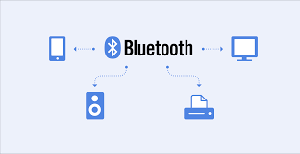
Bluetooth is a short-range wireless communication standard that allows devices to exchange data over radio waves. It eliminates the need for cables and provides secure, low-power, and efficient connectivity.
It operates in the unlicensed ISM band (2.4 GHz) using frequency-hopping spread spectrum.
Widely used for personal area networks (PANs).
History:
Developed in 1994 by Ericsson.
Named after the Viking King Harald Bluetooth, who united Danish tribes, symbolizing how Bluetooth unifies devices.
Purpose:
To create small wireless networks, referred to as personal area networks (PANs), for convenient communication.
Uses:
File sharing, audio streaming, device synchronization,
IoT connectivity, and more.

Slide 3
Key Features of Bluetooth:
Frequency Band:
Operates in the globally available 2.4 GHz ISM band, making it accessible worldwide.
Range:
Class 1 Devices: Up to 100 meters.
Class 2 Devices: Typical range of 10 meters (used in most consumer devices).
Class 3 Devices: Limited to a few meters.
Low Power Consumption:
Especially with Bluetooth Low Energy (BLE), designed for devices like fitness trackers and smartwatches.
Simple Connectivity:
Easy pairing process and automatic reconnection to paired devices.
Interoperability:
Compatible across various device types and brands due to standardized protocols.
Secure Communication:
Implements encryption and authentication to protect data.

Slide 4
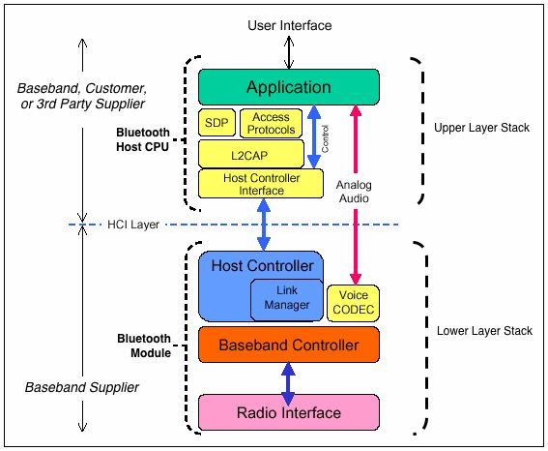
Bluetooth Architecture
Radio Layer:
Defines how devices transmit data wirelessly.
Uses frequency hopping to minimize interference, switching frequencies up to 1,600 times per second.
Baseband Layer:
Manages physical channels and time slots.
Defines packet structure for communication.
Link Manager Protocol (LMP):
Handles link establishment and maintenance.
Responsible for authentication, pairing, and security setup.
L2CAP (Logical Link Control and Adaptation Protocol):
Manages data transmission for higher layers.
Supports multiple protocols like audio and file transfer.
Service Discovery Protocol (SDP):
Enables devices to identify available services (e.g., printing, file sharing).

Slide 5
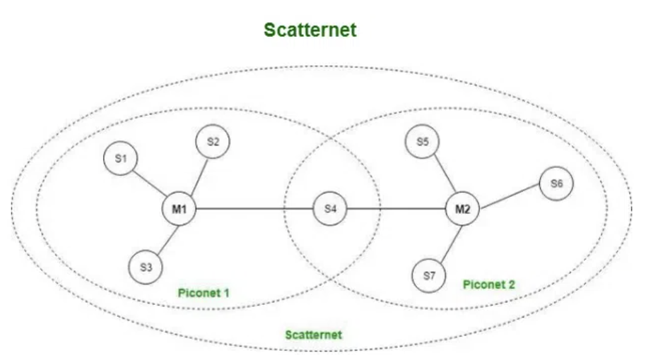
Types of Bluetooth Networks:
Piconet:
Small network with one master device controlling up to 7 slave devices.
Example: A smartphone controlling a wireless speaker and headset.
Scatternet:
Formed by connecting multiple piconets.
Devices act as bridges, facilitating communication across the network.
Used in IoT systems where multiple devices collaborate.
Bluetooth Versions:
Bluetooth Classic (v1.0 - v3.0):
Focused on audio and basic data transfer.
Supported devices like early wireless headphones and car systems.
Bluetooth Low Energy (BLE, v4.0 and beyond):
Introduced to support IoT devices with low power needs.
Ideal for devices like smartwatches, health sensors, and industrial IoT devices.
Bluetooth 5.0 and Later Versions:
Enhanced speed (up to 2 Mbps) and range (up to 240 meters in open spaces).
Introduced mesh networking, enabling devices to form large networks for smart cities or industrial setups.

Slide 6
Bluetooth in Distributed Systems:
Definition of Distributed Systems: A collection of independent devices working together to perform tasks or share resources.
Bluetooth's Role in Distributed Systems:
Device Collaboration: Enables devices to communicate and share workloads efficiently.
Decentralized Communication: Allows devices to form networks without a centralized server.
Real-Time Data Sharing: Supports time-sensitive operations like data collection in healthcare or automation.
Example: A distributed home automation system where lights, thermostats, and security cameras communicate via Bluetooth
Applications of Bluetooth in Distributed Systems​
Internet of Things (IoT):​
Connects smart devices like door locks, thermostats, and sensors.​
Bluetooth mesh networking ensures these devices can communicate seamlessly across large areas.​
Healthcare:​
Monitors and collects patient data through wearable devices.​
Examples: Heart rate monitors, glucose sensors, and remote patient tracking systems.
Education:
Enables file sharing between devices in classrooms.
Wireless projectors and collaborative tools utilize Bluetooth for ease of use.
Entertainment:
Connects speakers, headphones, gaming controllers, and other peripherals.

Slide 7
5.Industrial Automation:
Machines and sensors use Bluetooth to coordinate operations and collect data in factories.
Bluetooth Security Features​:
Security Risks:​
Eavesdropping: Intercepting Bluetooth communication.​
Man-in-the-Middle Attacks: Attacker inserts themselves into the communication.​
Bluetooth Security Solutions:​
Encryption: Encrypts data before transmission to prevent unauthorized access.​
Secure Pairing Methods:​
Numeric Comparison: Confirms pairing via passkeys.​
Out-of-Band (OOB): Uses an alternate channel, like NFC, for secure pairing.​
Frequency Hopping: Switches channels rapidly to prevent interception.​

Slide 8
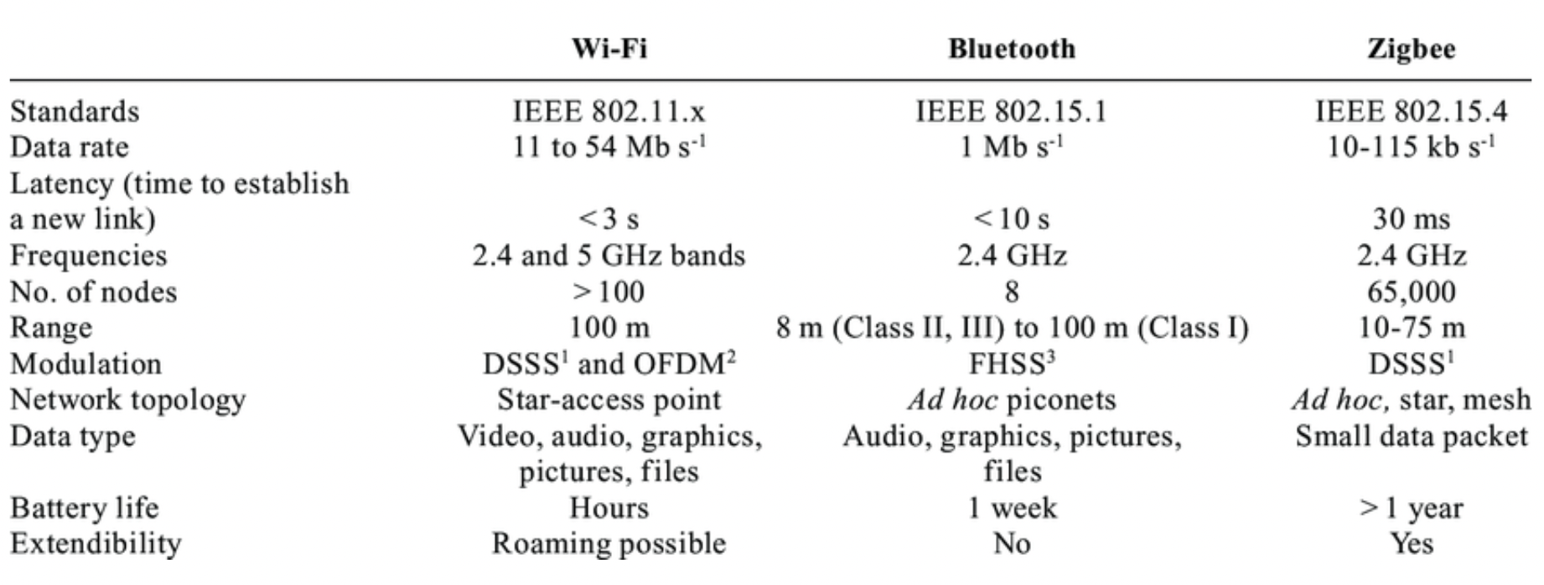
Bluetooth vs. Other Wireless Technologies
Bluetooth vs. Wi-Fi:
Bluetooth: Low power, ideal for short-range and low-data applications.
Wi-Fi: Higher speed and range, suitable for large file transfers and internet access.
Bluetooth vs. ZigBee:
ZigBee: Designed for low-power, large-scale IoT networks.
Bluetooth Mesh: More versatile, with better data rates and device support.
Bluetooth vs. NFC (Near Field Communication):
NFC: Limited to very short range (~10 cm).
Bluetooth: Offers greater range and supports more complex data transfers.

Slide 9
Advantages:
Wireless Connectivity: Eliminates cables for a cleaner setup.
Energy Efficiency: BLE ensures long battery life for devices.
Global Standard: Works across devices from different manufacturers.
Scalability: Supports small networks (piconets) and large IoT systems (mesh).
Limitations of Bluetooth:
Limited Range: Best suited for short distances.
Connection Limit: Only 7 active devices per piconet.
Interference: Shares spectrum with other technologies like Wi-Fi.
Data Rate: Not ideal for high-bandwidth applications like streaming HD video.
Future of Bluetooth in Distributed Systems:
Advancements in IoT: Supporting more connected devices with improved power efficiency.
Enhanced Range and Speed: Bluetooth 5+ is bridging the gap with technologies like Wi-Fi.
Focus on Security: New standards are addressing vulnerabilities in pairing and encryption.
Integration with AI: Smarter devices using Bluetooth to automate tasks and improve performance.

